Slide 1

Scaling Betsson Journey of the monolith Roger Johansson
Akka.NET Founder Twitter: @rogeralsing
Github: rogeralsing
Mail: roger.johansson@betsson.com
Github.com/rogeralsing/presentations

Slide 2






Who are we?

Slide 3
What to expect from this talk
I will not talk about Akka.NET
I am going to lie, I am under NDA, I cannot give you the full picture
A bit of history on where we came from in terms of architecture
Geekery about microservices, service discovery, Docker and .NET Core

Slide 4
The Past

Slide 5
One Brand, One System
Betsson
The Monolith

Slide 6
We acquired more brands
Betsafe
Betsson
NordicBet
?
The Monolith
?

Slide 7
Scaling the monolith
A monolithic application puts all its
functionality into a single process…
…and scales by replicating the
monolith on multiple servers
-Martin Fowler, James Lewis

Slide 8
Scaling by Instance
Instance 1
Instance 2
Instance 3
Brand A
Brand C
Brand D
Brand B

Slide 9
Introducing SOA
Instance 1
Instance 2
Instance 3
Customer
Customer
Customer
Gaming
Gaming
Gaming
Campaigns
Campaigns
Campaigns
…
…
…

Slide 10
Issues?

Slide 11
Point to point communication
Single Message Producer
Single Message Consumer
No Redundancy
Doesn’t Scale

Slide 12


Shared Servers, Noisy Neighbours
Instance
Customer
Gaming
Campaigns
…

Slide 13

Single point of failure…
Instance
Customer
Gaming
Campaigns
…

Slide 14
…Same issue with deployment
Down during deployment
Instance
Customer
Gaming
Campaigns
…

Slide 15
Issues!
Cannot scale beyond one server per service
Services compete for resources
Single point of failure
Downtime during deployment
No elasticity

Slide 16
The Current

Slide 17
Microservices

Slide 18
Scaling Microservices
A microservice architecture puts
each element of functionality into a
separate service…
…and scales by distributing these services
across servers, replicating as needed
-Martin Fowler, James Lewis

Slide 19
Scaling Microservices
Where are you guys!?
I’m over here!

Slide 20
Service Discovery
Service Registry
Publish ”I am A”
Publish ”I am B”
Service A
Service B

Slide 21
Service Discovery
Service Registry
Lookup ”Where is B?”
Service A
Service B
Call

Slide 22
Service Discovery
Service A
Service B
Service A
Service Registry
Service B
Service A
Service B

Slide 23
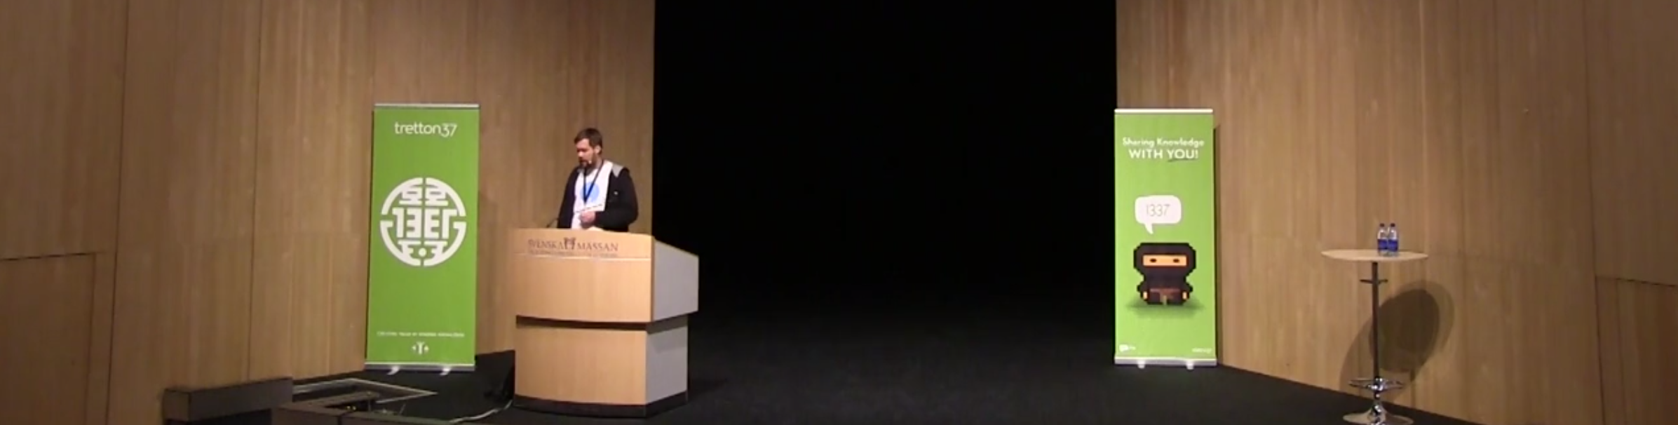
Leetspeak 2014, Niklas Gustavsson/Spotify
Service Discovery using DNS

Slide 24

Consul
λ Consul agent -server -bootstrap

Slide 25
Asp.NET Core

Slide 26

Microphone

Slide 27
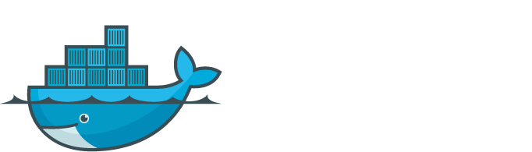

Slide 28
Isolation

Slide 29
Rancher.IO

Slide 30
Cluster Schedulers

Slide 31
Elastic Scaling

Slide 32
Zero Downtime Deploy

Slide 33
Connecting Docker and Legacy services

Slide 34
THE FUTURE

Slide 35





Slide 36
Why?
Built for concurrency
Built for distributed systems
Engaging communities

